Slide 1





Bootcamp on Gen AI and LLMs: Concepts and Applications
1st April to 4th April 2026
Next-Generation Speech AI: From Acoustic Foundations to Speech LLMs
Hands on Session
Dr Susmitha Vekkot
ASE, Bengaluru

Slide 2
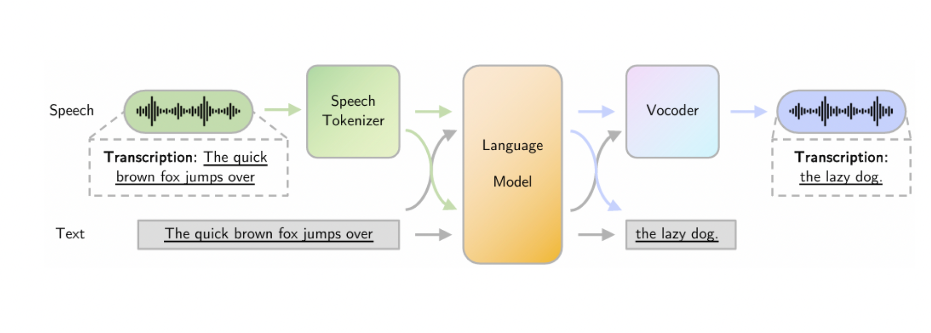
Speech LLM Pipeline Overview

Slide 3

Audio Formats Used in Speech LLM Pipelines
WAV (.wav), FLAC (.flac), MP3 (.mp3), M4A (.m4a), OGG (.ogg)
Standard Sampling Rates Used in Speech Models
8 kHz(telephony speech), 16 kHz(Whisper, HuBERT, Wav2Vec2), 44.1 kHz(music recordings)
Standard Speech Datasets Used in ASR and Speech-LLMs
LibriSpeech(1000 hours of English speech)

Slide 4


The Dual Nature of Speech
WHAT is Spoken (Semantic)
HOW it is Spoken (Acoustic)
Word Identity
Pitch & Tone
Recognition of specific words (e.g., "apple") and their literal
The frequency and quality of the voice, conveying emotion and
meaning.
emphasis.
Phoneme Structure
Emotion & Rhythm
The basic sound units that form words (e.g., /a/ /p/ /l/) in
Feelings expressed through vocal delivery and the timing/flow
linguistic structure.
of speech patterns.
Sentence Meaning
Speaker Identity & Style
Understanding whether speech is a statement, question,
Unique vocal characteristics and individual variations in
command, or other form.
pronunciation.

Slide 5
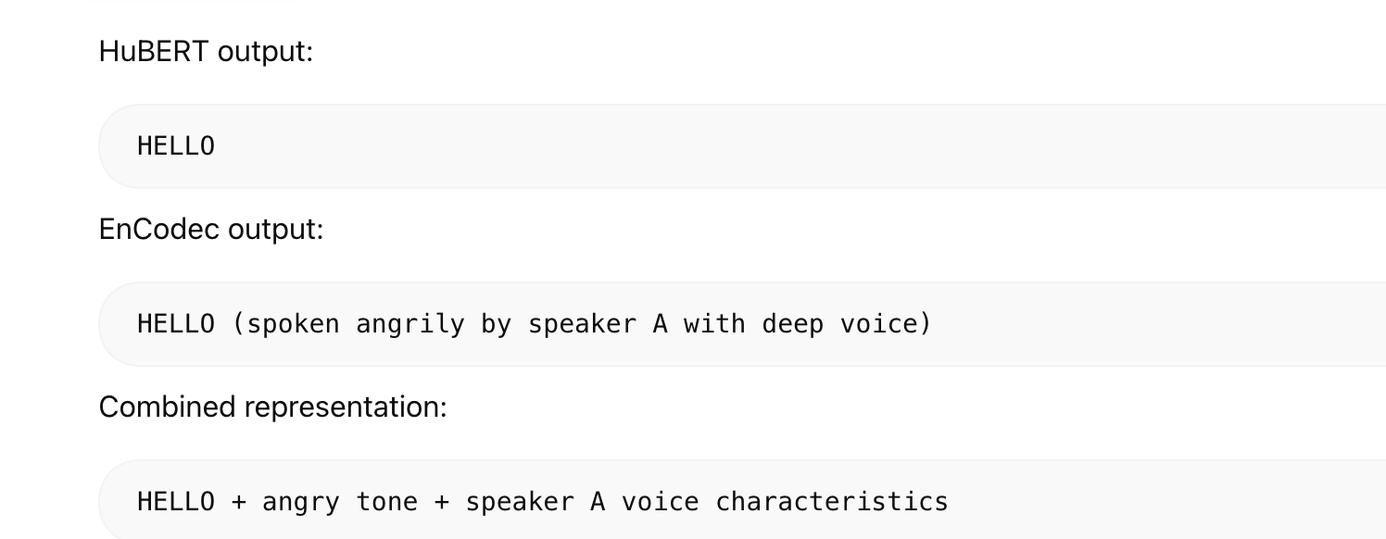

Slide 6




Real-World Applications of Speech Analysis
Speech Recognition
Semantic
Emotion Detection
Acoustic
Converts audio to text. Requires deep understanding of
Identifies speaker sentiment. Relies heavily on acoustic
semantic information, phonemes, and language models to
features like pitch variations, speech rate, and vocal energy
accurately transcribe spoken words.
to determine emotional state.
Speaker Verification
Acoustic
Language Learning
Both
Authenticates identity. Uses unique acoustic
Aids in language acquisition. Benefits from understanding
characteristics, vocal tract models, and pronunciation
both correct pronunciation (acoustic feedback) and
styles as a biometric security measure.
vocabulary/grammar meaning (semantic understanding).
Accessibility Technology
Both
Text-to-speech systems must synthesize both accurate semantic content and natural-sounding
acoustic delivery (prosody, intonation) for effective, human-like output.

Slide 7
Speech & Audio AI Models
Model | Purpose
SeamlessM4T | speech-to-speech translation
Whisper | speech-to-text transcription
HuBERT | semantic speech token extraction
EnCodec | acoustic speech token extraction
SpeechT5 | speech + text multimodal processing
AudioLM | speech token language modeling
SpeechGPT | speech conversation & QA
Qwen-Audio | speech reasoning & audio QA
Wav2Vec2 | phonetic speech embeddings

Slide 8

THE SPEECH LLM LANDSCAPE
KEY PLAYERS
OpenAI Realtime
Qwen-Audio Line
ECOSYSTEM
Google Gemini Live / Audio
MiniCPM-o
IBM Granite Speech
Amazon Nova Sonic
NVIDIA Riva Stack
Kyutai Moshi
Deepgram
Hume EVI
ElevenLabs
Meta SeamlessM4T
Microsoft Phi-4-multimodal
A rapidly growing ecosystem of end-to-end speech-language models spanning ASR, TTS, translation, and multimodal understanding.

Slide 9









APPLICATION ARCHITECTURE
Notebook Flow: SpeechLLM
01
NOTEBOOK 1
SARVAM API Key
Ask Question (Text)
Receive Answer (Text)
Direct Q&A via
SARVAM
Convert to Speech
02
NOTEBOOK 2
Load & Clean Text
Convert to Vectors
Compare User Question
Document-Based
Q&A
Return Relevant Answer
Convert to Speech
03
Upload Q&A Dataset
Create Embeddings
Speech Question to Text
NOTEBOOK 3
Multilingual Q&A
Find Similar Question
Retrieve Answer
Translate Answer
Convert to Speech
from Dataset
Play Audio

Slide 10
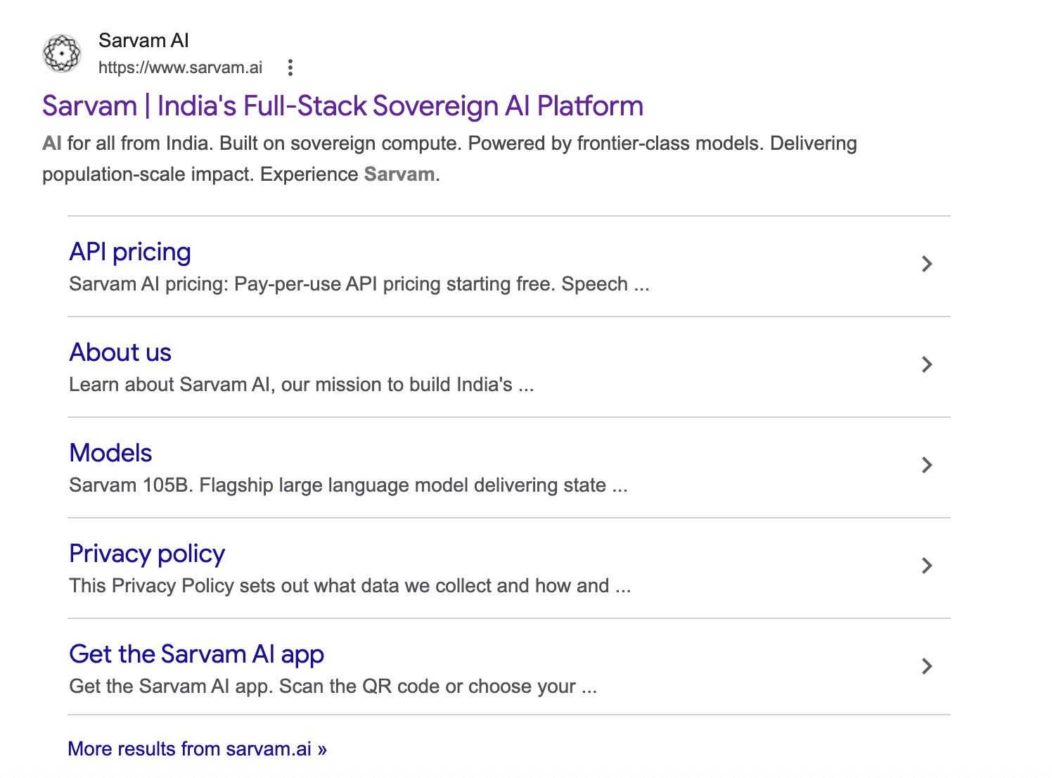
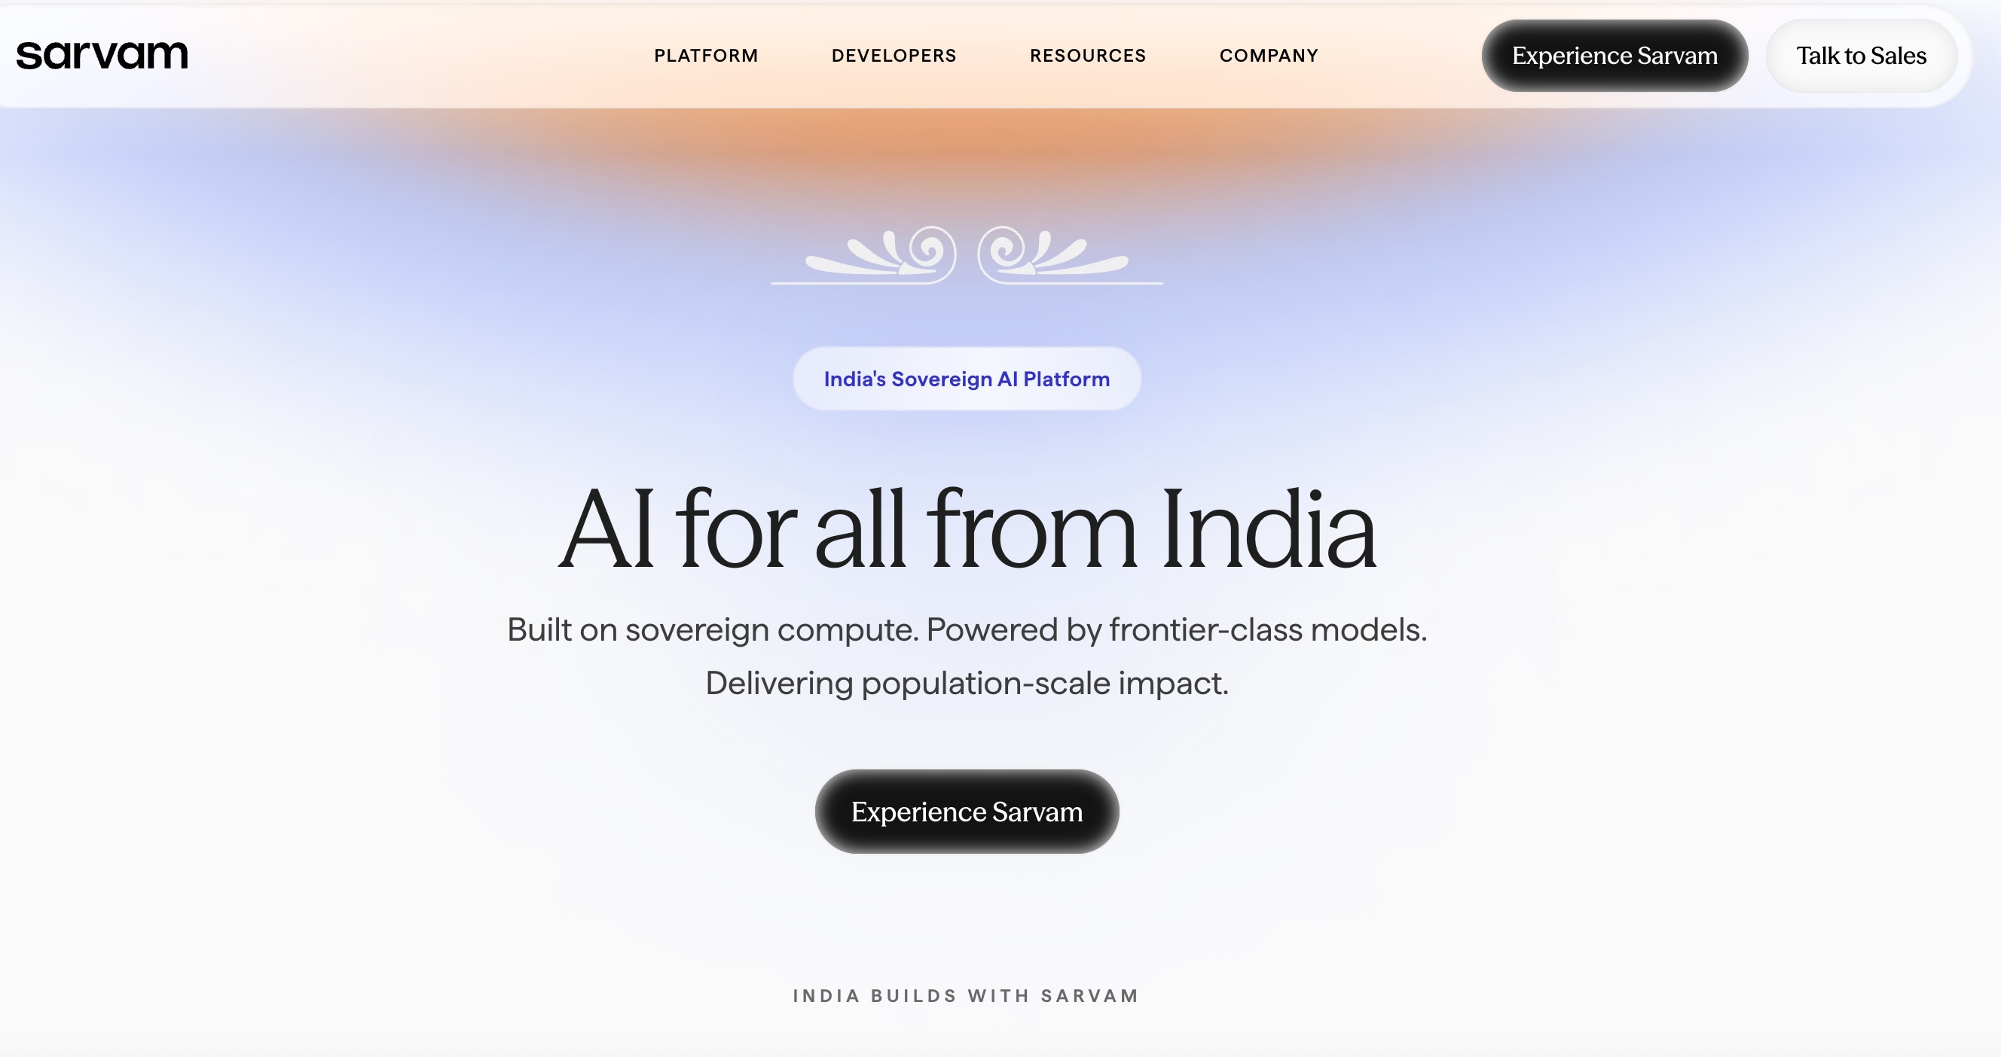
Sarvam
How to Create SARVAM API Key
Step-1
Step-2

Slide 11

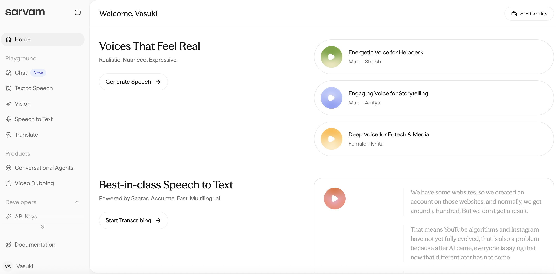
SARVAM
Step-3
Step-4

Slide 12
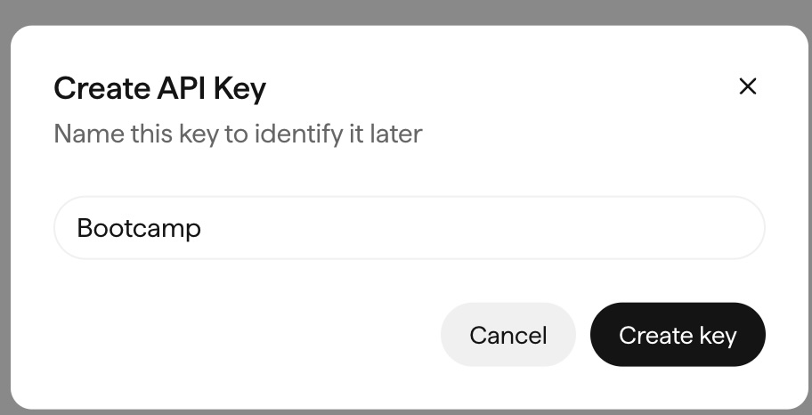
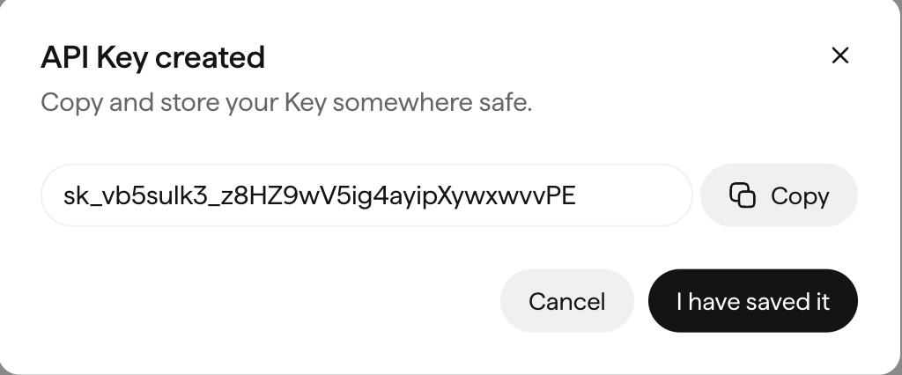
SARVAM
Step-5
Step-6
Step-7

Slide 13




CORE CAPABILITIES
SARVAM's Model Ecosystem
01
02
03
AI & Conversational
Neural Translation
Speech Processing
KEY MODELS
KEY MODELS
KEY MODELS
Sarvam-M, Samvaad
Mayura, Sarvam-Translate
Saarika (STT), Bulbul (TTS), Saaras (STT Translate)
Large language model and conversational AI tailored specifically for Indian languages and cultural contexts.
High-quality neural machine translation delivering accurate cross-lingual communication across Indian languages.
End-to-end speech pipeline providing robust acoustic foundations for Indian language audio processing.

Slide 14
APPLICATION ARCHITECTURE
Notebook Flow: SpeechLLM
01
NOTEBOOK 1
SARVAM API Key
Ask Question (Text)
Receive Answer (Text)
Direct Q&A via
SARVAM
Convert to Speech
02
NOTEBOOK 2
Load & Clean Text
Convert to Vectors
Compare User Question
Document-Based
Q&A
Return Relevant Answer
Convert to Speech
03
Upload Q&A Dataset
Create Embeddings
Speech Question to Text
NOTEBOOK 3
Multilingual Q&A
Find Similar Question
Retrieve Answer
Translate Answer
Convert to Speech
from Dataset
Play Audio

Slide 15










LIVE AUDIO + LLM
DEPLOYMENT OPTIONS
UI Frameworks
Realtime AI APIs
Gradio
Google AI Studio
Streamlit
OpenAI Realtime API
Chainlit
Google Gemini Live API
Hugging Face Spaces
Custom Web App
Pro Tip: Choose your stack based on deployment needs — from rapid prototyping with Gradio to production-grade custom web apps powered by Realtime APIs.

